Slide 1
ACURATE neo2TM v SAPIEN 3 UltraTM Head-to-Head Comparison

Slide 2
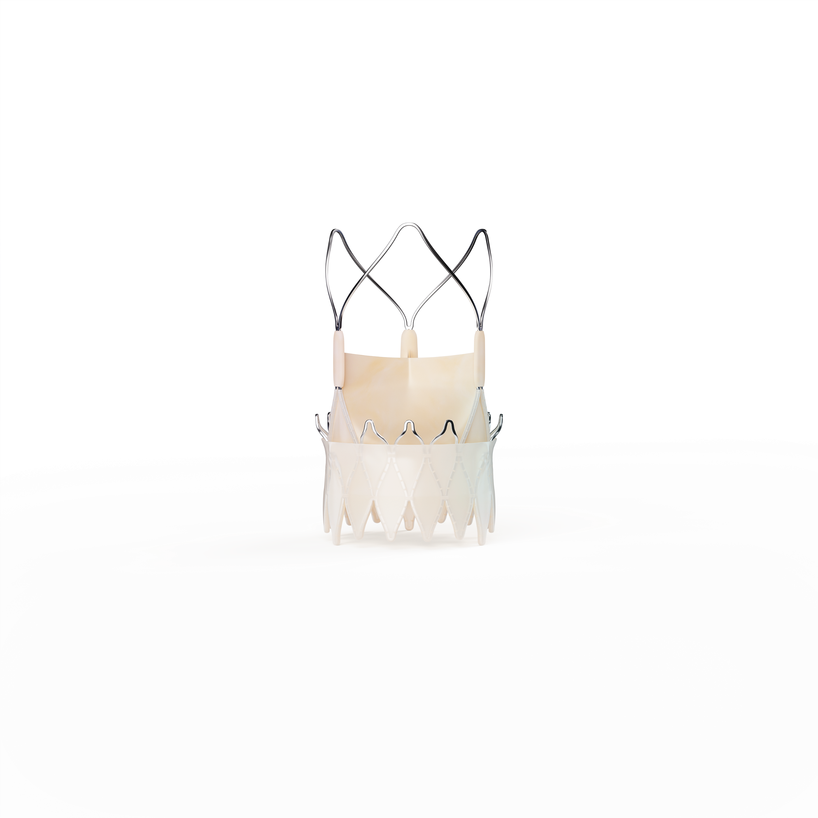
Device Overview ACURATE neo2 & SAPIEN 3 Ultra
ACURATE neo2 Aortic Valve System
Porcine Pericardium, Supra Annular Leaflets
Self-Expanding (Top-down) Nitinol frame
CE marked 2020
Not FDA Approved, Investigational Device in the US
SAPIEN 3 Ultra Transcatheter Heart Valve
Bovine Pericardium, Intra-annular Leaflets
Balloon-Expanding Cobalt-Chromium Frame
CE marked 2018
FDA Approved 2018
CAUTION: In Europe, ACURATE neo and neo2 Aortic Valve Systems are CE-marked. In the USA, ACURATE neo2 is an investigational device and restricted under federal law to investigational use only. Not available for sale.
Notes:
[DELIVERY NOTES]
ACURATE neo2 maintains key features of the ACURATE Platform:
14F iSLEEVE Introducer compatible
Self-expanding nitinol frame with porcine pericardium leaflets
Supra-annular positioning; two-step top-down deployment
Treats annuli from 21 mm to 27 mm
Sizes S –23 mm, M –25 mm, L –27 mm
Includes the ACURATE neo2 Active PVsealTM Technology to minimize moderate/severe PVL and overall burden of paravalvular leak and Radiopaque Positioning Marker for placement accuracy

Slide 3
Study Design 1st head-to-head comparison of ACURATE neo2 & SAPIEN 3 Ultra
Objective: To compare VARC-3 device and technical success (Primary Endpoint)
and 30-day VARC-3 clinical endpoints (Secondary Endpoint) of
ACURATE neo2 to SAPIEN 3 Ultra
Head-to-Head Transfemoral TAVR
n = 1356 Patients | 4 German Centers | Procedures performed: March 2019 – December 2021
ACURATE neo2
n=608
SAPIEN 3 Ultra
n=748
1:1 nearest neighbour matching
Age Female gender EuroScore I NYHA III/IV Coronary artery disease | Previous PCI Mean transvalvular gradient LVEF < 35% Bicuspid aortic valve | Mean annulus diameter Severe calcification Asymmetric calcification Indexed Effective Orifice Area (iEOA)
ACURATE neo2
n=472
SAPIEN 3 Ultra
n=472
CAUTION: In Europe, ACURATE neo and neo2 Aortic Valve Systems are CE-marked. In the USA, ACURATE neo2 is an investigational device and restricted under federal law to investigational use only. Not available for sale.
Pellegrini C. ACURATE neo2 versus SAPIEN 3 Ultra. EuroIntervention 2022.
Notes:
[DELIVERY NOTES]
Outcomes from a German multicenter comparison of the ACURATE neo2 and SAPIEN 3 Ultra TAVR valves were presented by Dr Won-Keun Kim from the Kerckhoff Klinik (Bad Nauheim, Germany) at the EuroPCR Congress 2022.
First direct head-to-head comparison of the 2nd generation ACURATE neo2 and 4th generation SAPIEN 3 Ultra valves
This study enrolled all eligible patients for both devices from respective commercial availability. SAPIEN 3 Ultra was CE marked November 2018 and ACURATE neo2 was CE marked April 2020 & commercialized September 2020. The inclusion of all patients treated in this extended time period allows for improved validity of the analysis.

Slide 4
Baseline Characteristics
ACURATE neo2 & SAPIEN 3 Ultra
 | Matched population
 | ACURATE neo2 n=472 | SAPIEN 3 Ultra n=472 | p-value
Age, years | 82.0 [78.7 – 85.0] | 81.6 [77.6 – 85.1] | 0.584
Female gender | 239 (50.6) | 246 (52.1) | 0.696
Logistic EuroScore, % | 13.8 [7.9 – 23.0] | 12.5 [7.9 - 21.9] | 0.184
NYHA III/IV | 305 (64.6) | 297 (62.9) | 0.636
Coronary artery disease | 340 (72.0) | 336 (71.2) | 0.829
Previous myocardial infarction | 50 (10.6) | 54 (11.4) | 0.755
Previous stroke | 57 (12.1) | 55 (11.7) | 0.920
COPD | 57 (12.1) | 56 (11.9) | 0.999
Peripheral artery disease | 61 (12.9) | 81 (17.2) | 0.083
eGFR, ml/min | 65.0 [47.0 – 84.3] | 62.0 [47.7 – 79.0] | 0.198
Previous pacemaker | 57 (12.1) | 46 (9.7) | 0.296
Atrial fibrillation | 190 (40.3) | 191 (40.5) | 0.999
Right bundle-branch block | 50 (10.6) | 60 (12.7) | 0.361
LVEF <35% | 17 (3.6) | 13 (2.8) | 0.579
Mean gradient, mmHg | 43.0 [34.0 – 52.0] | 42.5 [34.8 – 51.0] | 0.940
Bicuspid aortic valve | 20 (4.2) | 25 (5.3) | 0.542
Severe aortic valve calcification | 114 (24.3) | 115 (24.4) | 0.954
Asymmetric calcification | 120 (25.4) | 135 (28.6) | 0.305
Mean annulus diameter, mm | 23.8 [22.4, 25.2] | 24.9 [23.4, 26.2] | <0.001
NOTE: 1:1 Propensity Score-Matching (PSM) was performed to reduce any imbalance in baseline demographics, and clinical & echocardiographic characteristics from the entire population
CAUTION: In Europe, ACURATE neo and neo2 Aortic Valve Systems are CE-marked. In the USA, ACURATE neo2 is an investigational device and restricted under federal law to investigational use only. Not available for sale.
Pellegrini C. ACURATE neo2 versus SAPIEN 3 Ultra. EuroIntervention 2022.
Notes:
Delivery Notes:
After 1:1 matching, the only significant difference seen in baseline characteristics is mean annulus diameter.

Slide 5
Essential Outcomes
ACURATE neo2 & SAPIEN 3 Ultra
 | ACURATE neo2 n=472 | SAPIEN 3 Ultra n=472 | p-value
Pre-dilatation, n (%) | 434 (91.9) | 148 (31.4) | <0.001
Post-dilatation, n (%) | 211 (44.7) | 69 (14.6) | <0.001
Procedural time, min | 45.0 [36.0 – 59.0] | 46.0 [35.0 – 57.0] | 0.472
Fluoroscopy time, min | 9.8 [7.3 - 13.8] | 10.2 [6.9 - 14.1] | 0.974
Technical success (VARC-3) ‡ | 448 (94.9) | 450 (95.3) | 0.880
Device success (VARC-3)‡‡ | 434 (91.9) | 401 (85.0) | 0.001
Contrast agent, ml | 40.0 [22.0, 130.0] | 117.5 [37.8, 160.0] | <0.001
Pre-discharge moderate/severe PVL n (%)* | 3 (0.6) | 5 (1.1) | 0.723
Pre-discharge Mean gradient ≥ 20mmHg, n (%) | 11 (2.4) | 36 (7.7) | <0.001
Indexed effective orifine area (cm²)** | 0.9 [0.8, 1.1] (n=342) | 0.8 [0.7, 0.9] (n=167) | <0.001
Severe PPM, n (%)** | 10/342 (2.9) | 25/167 (15.0) | <0.001
Major vascular complication (VARC-3) | 29 (6.1) | 45 (9.5) | 0.069
Coronary obstruction requiring PCI | 1 (0.2) | 2 (0.4) | 0.999
Annular rupture, n (%) | 1 (0.2) | 0 (0) | 0.999
Acute Kidney Injury Network (AKIN) 2-4, n (%) | 15 (3.2) | 15 (3.2) | 0.999
30-day All-stroke** | 16/464 (3.4) | 11/465 (2.4) | 0.435
30-day Pacemaker implantation, n (%)** | 33/406 (8.1) | 43/419 (10.3) | 0.289
30-day mortality, n (%)** | 8/464 (1.7) | 11/465 (2.4) | 0.646
NOTE: Reported outcomes reflect the PSM population. Outcomes for the entire population are in line with PSM results.
‡ Defined as Freedom from mortality. Successful access, delivery of the device and retrieval of the delivery system. Correct positioning of a single prosthetic heart valve into the proper anatomical location. Freedom from surgery or intervention related to the device or to a major vascular or access-related, or cardiac structural complication.
‡‡Defined as freedom from mortality, surgery or intervention related to the device or to a major vascular or access-related or cardiac structural complication and intended performance of the valve (mean gradient <20 mmHg, peak velocity <3 m/s, Doppler velocity index =0.25 and less than moderate AR).
*Pre-discharge echocardiogram assessed. 10/1356 assessed by angio
** Data not available for full population. Sample sizes as indicated.
CAUTION: In Europe, ACURATE neo and neo2 Aortic Valve Systems are CE-marked. In the USA, ACURATE neo2 is an investigational device and restricted under federal law to investigational use only. Not available for sale.
Pellegrini C. ACURATE neo2 versus SAPIEN 3 Ultra. EuroIntervention 2022.
Notes:
Delivery Notes:
This is the 1st direct head-to-head comparative study of the 2nd generation ACURATE neo2 and 4th generation SAPIEN 3 Ultra valves, demonstrating favorable ACURATE neo2 outcomes:
Paravalvular Leak: The rate of echocardiogram assessed moderate to severe PVL was low and similar for both THVs (0.6% vs. 1.1%, p=0.723). ACURATE neo2 recorded 32.8% mild and 66.5% none PVL rates¹.
Gradients: ACURATE neo2 demonstrated significantly lower mean gradients (9±4 vs 13±4 mmHg; p<0.001), and a lower rate of elevated (≥20mmHg) gradients (2.4% vs 7.7%; p<0.001) and significantly larger Indexed Effective Orifice Area (iEOAs) (0.92cm² [0.79, 1.05] vs. 0.78 cm² [0.67, 0.91]; p<0.001)‡. This translated into a significantly lower rate of severe prosthesis-patient mismatch (2.9% vs 15.0%; p<0.001‡) and a superior device success rate (91.9% vs. 85%; p=0.001) for ACURATE neo2¹
Permanent Pacemaker Implantation: The 30-day new permanent pacemaker implantation rate was low and similar for both THVs (8.1% vs 10.3%; p=0.289)*¹.
In-Hospital & 30-day Events: Rates of in-hospital and 30-day events were overall low, and comparable between both THVs¹.

Slide 6
Essential Matched Cohort Outcomes
ACURATE neo2 & SAPIEN 3 Ultra
Similar and low Rates of PVL
Lower Mean Gradients
Lower Severe Prothesis-Patient Mismatch
P = 0.686
Before TAVR
After TAVR
0.6%
1.1%
43+9 vs 43+8 mmHg
9+4 vs 13+4 mmHg
P < 0.001
P = 0.940
2.9%
ACURATE neo2
2.9% Severe PPM
P < 0.001
ACURATE
neo2
SAPIEN 3
Ultra
15.0%
SAPIEN 3 Ultra
15.0% Severe PPM
Mild
None
Moderate or Severe
ACURATE
neo2
SAPIEN 3
Ultra
0.6% Moderate to Severe PVL vs. 1.1% with SAPIEN 3 Ultra p=0.723 | 2.4% Elevated Gradients* vs. 7.7% with SAPIEN 3 Ultra p < 0.001 | 91.9% Device success vs. 85.0% with SAPIEN 3 Ultra p = 0.001
*(≥ 20mmHg)
CAUTION: In Europe, ACURATE neo and neo2 Aortic Valve Systems are CE-marked. In the USA, ACURATE neo2 is an investigational device and restricted under federal law to investigational use only. Not available for sale.
Pellegrini C. ACURATE neo2 versus SAPIEN 3 Ultra. EuroIntervention 2022.
Notes:
Delivery Notes:
This is the 1st direct head-to-head comparative study of the 2nd generation ACURATE neo2 and 4th generation SAPIEN 3 Ultra valves, demonstrating favorable ACURATE neo2 outcomes:
Paravalvular Leak: The rate of echocardiogram assessed moderate to severe PVL was low and similar for both THVs (0.6% vs. 1.1%, p=0.723). ACURATE neo2 recorded 32.8% mild and 66.5% none PVL rates¹.
Gradients: ACURATE neo2 demonstrated significantly lower mean gradients (9±4 vs 13±4 mmHg; p<0.001), and a lower rate of elevated (≥20mmHg) gradients (2.4% vs 7.7%; p<0.001) and significantly larger Indexed Effective Orifice Area (iEOAs) (0.92cm² [0.79, 1.05] vs. 0.78 cm² [0.67, 0.91]; p<0.001)‡. This translated into a significantly lower rate of severe prosthesis-patient mismatch (2.9% vs 15.0%; p<0.001‡) and a superior device success rate (91.9% vs. 85%; p=0.001) for ACURATE neo2¹
Permanent Pacemaker Implantation: The 30-day new permanent pacemaker implantation rate was low and similar for both THVs (8.1% vs 10.3%; p=0.289)*¹.
In-Hospital & 30-day Events: Rates of in-hospital and 30-day events were overall low, and comparable between both THVs¹.

Slide 7
Conclusions
ACURATE neo2 & SAPIEN 3 Ultra
First direct head-to-head propensity score matched comparison of the 2nd generation ACURATE neo2 and 4th generation SAPIEN 3 Ultra valves
Data from this study demonstrated:
Low and similar rates of Moderate/Severe PVL (0.6% vs 1.1%; p=0.723)* and Permanent Pacemaker Implantation (8.1% vs 10.3%; p=0.289)** for ACURATE neo2 and SAPIEN 3 Ultra¹
Significantly lower rate of Elevated Gradients (2.4% vs. 7.7%; p<0.001)* for ACURATE neo2, resulting in a superior Device Success rate (91.9% vs. 85.0%; p=0.001)¹
ACURATE neo2 also demonstrated a lower rate of Severe Prosthesis-Patient Mismatch (2.9% vs 15.0%; p<0.001)*. Studies have demonstrated severe PPM to be associated with short and long-term mortality, heart failure rehospitalizations and premature structural valve degeneration^{1,2,3,4}
* Pre-Discharge **30-day
¹Pellegrini C. ACURATE neo2 versus SAPIEN 3 Ultra. EuroIntervention 2022. ²Herrmann HC, et al. J Am Coll Cardiol. December 4, 2018;72(22):2701-2711. ³Flameng, et al. Circulation. 2010;121:2123-2129. ⁴Pompeu Sá M, et al. Impact of Prosthesis-Patient Mismatch After Transcatheter Aortic Valve Replacement. JACC: Cardiovascular Imaging. 2022 Article In Press.
CAUTION: In Europe, ACURATE neo and neo2 Aortic Valve Systems are CE-marked. In the USA, ACURATE neo2 is an investigational device and restricted under federal law to investigational use only. Not available for sale.
Notes:
Delivery Notes:
This is the 1st direct head-to-head comparative study of the 2nd generation ACURATE neo2 and 4th generation SAPIEN 3 Ultra valves, demonstrating favorable ACURATE neo2 outcomes:
Paravalvular Leak: The rate of echocardiogram assessed moderate to severe PVL was low and similar for both THVs (0.6% vs. 1.1%, p=0.723). ACURATE neo2 recorded 32.8% mild and 66.5% none PVL rates¹.
Gradients: ACURATE neo2 demonstrated significantly lower mean gradients (9±4 vs 13±4 mmHg; p<0.001), and a lower rate of elevated (≥20mmHg) gradients (2.4% vs 7.7%; p<0.001) and significantly larger Indexed Effective Orifice Area (iEOAs) (0.92cm² [0.79, 1.05] vs. 0.78 cm² [0.67, 0.91]; p<0.001)‡. This translated into a significantly lower rate of severe prosthesis-patient mismatch (2.9% vs 15.0%; p<0.001‡) and a superior device success rate (91.9% vs. 85%; p=0.001) for ACURATE neo2¹
Permanent Pacemaker Implantation: The 30-day new permanent pacemaker implantation rate was low and similar for both THVs (8.1% vs 10.3%; p=0.289)*¹.
In-Hospital & 30-day Events: Rates of in-hospital and 30-day events were overall low, and comparable between both THVs¹.

Slide 8
Study Limitations
ACURATE neo2 & SAPIEN 3 Ultra
This is a non-randomized study, which incorporates 1:1 propensity matching (PSM), which does not fully exclude selection biases.
Site-reported data are reported. No independent Core-Laboratory or Clinical Event Committee adjudication have been used in this study.
Extremely calcified patients were excluded from this study.
CAUTION: In Europe, ACURATE neo and neo2 Aortic Valve Systems are CE-marked. In the USA, ACURATE neo2 is an investigational device and restricted under federal law to investigational use only. Not available for sale.
Pellegrini C. ACURATE neo2 versus SAPIEN 3 Ultra. EuroIntervention 2022.

Slide 9
Backup: Entire Population Baseline Characteristics and Essential Outcomes

Slide 10
Baseline Characteristics
ACURATE neo2 & SAPIEN 3 Ultra
 | Entire population |  |  | Matched population
 | ACURATE neo2 n=608 | SAPIEN 3 Ultra n=748 | p-value | ACURATE neo2 n=472 | SAPIEN 3 Ultra n=472 | p-value
Age, years | 82.0 [78.7 – 85.0] | 81.4 [77.1 – 85.0] | 0.032 | 82.0 [78.7 – 85.0] | 81.6 [77.6 – 85.1] | 0.584
Female gender | 289 (47.5) | 398 (53.2) | 0.038 | 239 (50.6) | 246 (52.1) | 0.696
Logistic EuroScore, % | 14.4 [8.1 – 23.4] | 12.3 [7.7 - 21.3] | 0.008 | 13.8 [7.9 – 23.0] | 12.5 [7.9 - 21.9] | 0.184
NYHA III/IV | 420 (69.1) | 429 (57.4) | <0.001 | 305 (64.6) | 297 (62.9) | 0.636
Coronary artery disease | 376 (61.8) | 558 (74.6) | <0.001 | 340 (72.0) | 336 (71.2) | 0.829
Previous myocardial infarction | 58 (9.5) | 87 (11.6) | 0.251 | 50 (10.6) | 54 (11.4) | 0.755
Previous stroke | 77 (12.7) | 94 (12.6) | 0.999 | 57 (12.1) | 55 (11.7) | 0.920
COPD | 74 (12.2) | 86 (11.5) | 0.735 | 57 (12.1) | 56 (11.9) | 0.999
Peripheral artery disease | 84 (13.8) | 130 (17.4) | 0.085 | 61 (12.9) | 81 (17.2) | 0.083
eGFR, ml/min | 65.0 [47.0 – 83.0] | 64.0 [48.5 – 79.5] | 0.684 | 65.0 [47.0 – 84.3] | 62.0 [47.7 – 79.0] | 0.198
Previous pacemaker | 75 (12.3) | 71 (9.5) | 0.095 | 57 (12.1) | 46 (9.7) | 0.296
Atrial fibrillation | 256 (42.1) | 291 (38.9) | 0.243 | 190 (40.3) | 191 (40.5) | 0.999
Right bundle-branch block | 56 (9.2) | 85 (11.4) | 0.211 | 50 (10.6) | 60 (12.7) | 0.361
LVEF <35% | 17 (2.8) | 42 (5.6) | 0.011 | 17 (3.6) | 13 (2.8) | 0.579
Mean gradient, mmHg | 42.0 [31.3 – 50.0] | 44.0 [37.0 – 54.0] | <0.001 | 43.0 [34.0 – 52.0] | 42.5 [34.8 – 51.0] | 0.940
Bicuspid aortic valve | 20 (3.3) | 97 (13.0) | <0.001 | 20 (4.2) | 25 (5.3) | 0.542
Severe aortic valve calcification | 126/606 (20.8) | 206/747 (27.6) | 0.004 | 114 (24.3) | 115 (24.4) | 0.954
Asymmetric calcification | 123 (20.2) | 336 (44.9) | <0.001 | 120 (25.4) | 135 (28.6) | 0.305
Mean annulus diameter, mm | 23.7 [22.4, 25.1] | 24.9 [23.4, 26.2] | <0.001 | 23.8 [22.4, 25.2] | 24.9 [23.4, 26.2] | <0.001
CAUTION: In Europe, ACURATE neo and neo2 Aortic Valve Systems are CE-marked. In the USA, ACURATE neo2 is an investigational device and restricted under federal law to investigational use only. Not available for sale.
Pellegrini C. ACURATE neo2 versus SAPIEN 3 Ultra. EuroIntervention 2022.
Notes:
Delivery Notes:
After 1:1 matching, the only significant difference seen in baseline characteristics is mean annulus diameter.

Slide 11
Essential Outcomes
ACURATE neo2 & SAPIEN 3 Ultra
 | ACURATE neo2 n=608 | SAPIEN 3 Ultra n=748 | p-value | ACURATE neo2 n=472 | SAPIEN 3 Ultra n=472 | p-value
Pre-dilatation, n (%) | 534 (87.8) | 268 (35.8) | <0.001 | 434 (91.9) | 148 (31.4) | <0.001
Post-dilatation, n (%) | 250 (41.4) | 111 (14.8) | <0.001 | 211 (44.7) | 69 (14.6) | <0.001
Procedural time, min | 44.0 [35.0 – 59.0] | 46.0 [35.0 – 58.0] | 0.867 | 45.0 [36.0 – 59.0] | 46.0 [35.0 – 57.0] | 0.472
Fluoroscopy time, min | 9.4 [7.0 - 13.3] | 10.2 [7.1 - 14.6] | 0.033 | 9.8 [7.3 - 13.8] | 10.2 [6.9 - 14.1] | 0.974
Technical success (VARC-3) | 575 (94.6) | 714 (95.5) | 0.529 | 448 (94.9) | 450 (95.3) | 0.880
Device success (VARC-3) | 557 (91.6) | 626 (83.7) | <0.001 | 434 (91.9) | 401 (85.0) | 0.001
Contrast agent, ml | 40.0 [20.0, 116.0] | 115.0 [36.0, 160.0] | <0.001 | 40.0 [22.0, 130.0] | 117.5 [37.8, 160.0] | <0.001
Pre-discharge moderate/severe PVL n (%)* | 4 (0.7) | 6 (0.8) | 1.000 | 3 (0.6) | 5 (1.1) | 0.723
Pre-discharge Mean gradient ≥ 20mmHg, n (%) | 11 (1.8) | 69 (9.3) | <0.001 | 11 (2.4) | 36 (7.7) | <0.001
Indexed effective orifine area (cm²)** | 0.9 [0.8, 1.1] (n=453) | 0.8 [0.7, 0.9] (n=261) | <0.001 | 0.9 [0.8, 1.1] (n=342) | 0.8 [0.7, 0.9] (n=167) | <0.001
Severe PPM, n (%)** | 10/453 (2.2) | 39/261 (14.9) | <0.001 | 10/342 (2.9) | 25/167 (15.0) | <0.001
Major vascular complication (VARC-3) | 39 (6.4) | 66 (8.8) | 0.122 | 29 (6.1) | 45 (9.5) | 0.069
Coronary obstruction requiring PCI | 1 (0.2) | 3 (0.4) | 0.768 | 1 (0.2) | 2 (0.4) | 0.999
Annular rupture, n (%) | 1 (0.2) | 2 (0.3) | 1.000 | 1(0.2) | 0 (0) | 0.999
Acute kidney injury St 2-4, n (%) | 18 (3.0) | 23 (3.1) | 0.999 | 15 (3.2) | 15 (3.2) | 0.999
30-day All-stroke** | 18/598 (3.0) | 23/734 (3.1) | 0.999 | 16/464 (3.4) | 11/465 (2.4) | 0.435
30-day Pacemaker implantation, n (%)** | 40/522 (7.7) | 70/664 (10.5) | 0.090 | 33/406 (8.1) | 43/419 (10.3) | 0.289
30-day mortality, n (%)** | 11/598 (1.8) | 18/734 (2.5) | 0.566 | 8/464 (1.7) | 11/465 (2.4) | 0.646
* Pre-discharge echocardiogram assessed. 10/1356 assessed by angio ** Data not available for full population. Sample sizes as indicated.
CAUTION: In Europe, ACURATE neo and neo2 Aortic Valve Systems are CE-marked. In the USA, ACURATE neo2 is an investigational device and restricted under federal law to investigational use only. Not available for sale.
Pellegrini C. ACURATE neo2 versus SAPIEN 3 Ultra. EuroIntervention 2022.
Notes:
Delivery Notes:
This is the 1st direct head-to-head comparative study of the 2nd generation ACURATE neo2 and 4th generation SAPIEN 3 Ultra valves, demonstrating favorable ACURATE neo2 outcomes:
Paravalvular Leak: The rate of echocardiogram assessed moderate to severe PVL was low and similar for both THVs (0.6% vs. 1.1%, p=0.723). ACURATE neo2 recorded 32.8% mild and 66.5% none PVL rates¹.
Gradients: ACURATE neo2 demonstrated significantly lower mean gradients (9±4 vs 13±4 mmHg; p<0.001), and a lower rate of elevated (≥20mmHg) gradients (2.4% vs 7.7%; p<0.001) and significantly larger Indexed Effective Orifice Area (iEOAs) (0.92cm² [0.79, 1.05] vs. 0.78 cm² [0.67, 0.91]; p<0.001)‡. This translated into a significantly lower rate of severe prosthesis-patient mismatch (2.9% vs 15.0%; p<0.001‡) and a superior device success rate (91.9% vs. 85%; p=0.001) for ACURATE neo2¹
Permanent Pacemaker Implantation: The 30-day new permanent pacemaker implantation rate was low and similar for both THVs (8.1% vs 10.3%; p=0.289)*¹.
In-Hospital & 30-day Events: Rates of in-hospital and 30-day events were overall low, and comparable between both THVs¹.

