Slide 1
TAVI with Self-Expanding ACURATE neo2: Post-Procedural Hemodynamic and Short-Term Clinical Outcomes
The ITAL-neo Registry
CAUTION: In Europe, the ACURTE neo2 Aortic Valve System is CE-marked. Approved for physician use only. In the USA, the ACURATE neo2 Valve is an Investigational Device and restricted under federal law to investigational use only. Product(s) shown for informational purposes only – not meant as promotion or offer for sale.

Slide 2
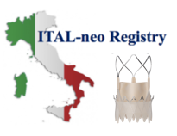
ITAL-neo Registry Study Design
Objective: To assess safety and efficacy of ACURATE neo2 in patients
with severe native aortic stenosis
Consecutive Patients with severe aortic stenosis treated with
ACURATE neo and ACURATE neo2
13 Italian Centers | Procedures performed: September 1st 2019 – May 31st 2021
Valve in Valve
Pure AR
Alternative access from trans-femoral or Trans-subclavian
ACURATE neo
N=680
(98.9% TF-TAVI)
ACURATE neo2
N=220
(99.1% TF-TAVI)
1:1 propensity score matching*
ACURATE neo
N=205
(100% TF-TAVI)
ACURATE neo2
N=220
(100% TF-TAVI)
*All patients enrolled in the ACURATE neo arm were consecutive patients. No pre-selection was performed in the PS-Matched population.
CAUTION: In Europe, the ACURTE neo2 Aortic Valve System is CE-marked. Approved for physician use only. In the USA, the ACURATE neo2 Valve is an Investigational Device and restricted under federal law to investigational use only. Product(s) shown for informational purposes only – not meant as promotion or offer for sale.

Slide 3
ITAL-neo Registry Study Summary
Design | Investigator-initiated and conducted, sequential two-arm multicenter Registry 13 Italian centers
Objective | To assess the safety and efficacy of the ACURATE neo2 Aortic Valve System in patients with severe aortic valve stenosis.
Primary Endpoint | More-than-mild post-procedural paravalvular leak incidence at pre-discharge echocardiogram.
Secondary Endpoints | Post-procedural technical success according to VARC 3* 90-day device success according to VARC 3** (composite of technical success). 90-day safety according to VARC 3 (composite of freedom from all-cause mortality, all stroke, VARC type 2-4 bleeding, major vascular complication, AKI stage 3 or 4, moderate or severe AR, new permanent pacemaker (PPM) or intervention related to the device).
Sample Size | 900 consecutive patients with severe native aortic valve stenosis. Enrollment started on September 1st 2019 and completed on May 1st 2021.
*Technical success according to VARC 3: Freedom from mortality. Successful access, delivery of the device and retrieval of the delivery system. Correct positioning of a single prosthetic heart valve into the proper anatomical location. Freedom from surgery or intervention related to the device or to a major vascular or access-related, or cardiac structural complication.
**Device success according to VARC 3 : freedom from mortality, freedom from surgery or intervention related to the device or to a major vascular or access-related or cardiac structural complication and intended performance of the valve (mean gradient <20 mmHg, peak velocity <3 m/s, Doppler velocity index =0.25 and less than moderate AR).
CAUTION: In Europe, the ACURTE neo2 Aortic Valve System is CE-marked. Approved for physician use only. In the USA, the ACURATE neo2 Valve is an Investigational Device and restricted under federal law to investigational use only. Product(s) shown for informational purposes only – not meant as promotion or offer for sale.

Slide 4
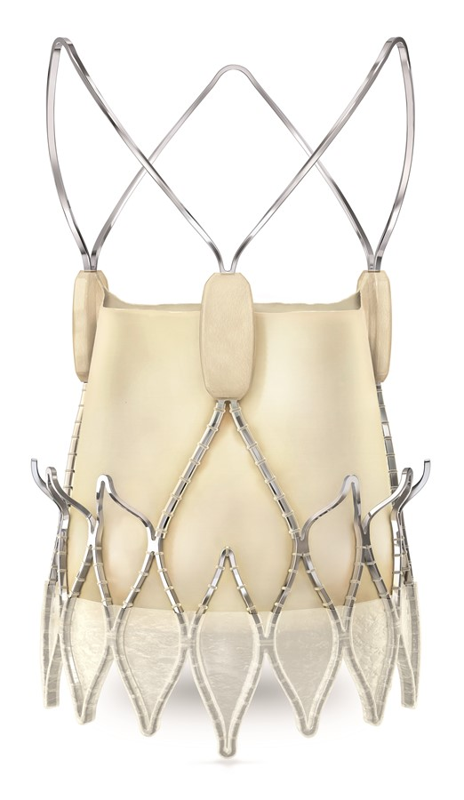
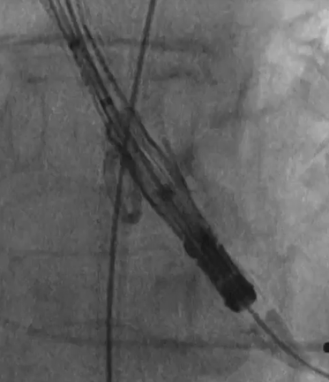
Comparing ACURATE neo and ACURATE neo2
ACURATE neo Aortic Valve System
Common
Features
ACURATE neo2 Aortic Valve System
Radiopaque Positioning Marker
Open Stabilization Arches
Supra Annular
Leaflets
Upper Crown
Outer Skirt
Taller (+60%) ActivePVTM Seal Technology
Lower Crown
CAUTION: In Europe, the ACURTE neo2 Aortic Valve System is CE-marked. Approved for physician use only. In the USA, the ACURATE neo2 Valve is an Investigational Device and restricted under federal law to investigational use only. Product(s) shown for informational purposes only – not meant as promotion or offer for sale.

Slide 5
Baseline Characteristics Propensity-Score Matched Population
P=1.00
No significant differences between the ACURATE neo and neo2 patient populations
CAUTION: In Europe, the ACURTE neo2 Aortic Valve System is CE-marked. Approved for physician use only. In the USA, the ACURATE neo2 Valve is an Investigational Device and restricted under federal law to investigational use only. Product(s) shown for informational purposes only – not meant as promotion or offer for sale.

Slide 6
Baseline ECG and Echo Characteristics Propensity-Score Matched Population
P=1.00
P=1.00
Baseline ECG and echocardiographic characteristics were non-significantly different between ACURATE neo and ACURATE neo2.
Although statistically non-significant, there was a numerically higher percentage of patients with RBBB in the ACURATE neo2 patient population vs ACURATE neo.
CAUTION: In Europe, the ACURTE neo2 Aortic Valve System is CE-marked. Approved for physician use only. In the USA, the ACURATE neo2 Valve is an Investigational Device and restricted under federal law to investigational use only. Product(s) shown for informational purposes only – not meant as promotion or offer for sale.

Slide 7
Multi-slice computer tomography (MSCT) Characteristics
MILD
MODERATE
SEVERE
CAUTION: In Europe, the ACURTE neo2 Aortic Valve System is CE-marked. Approved for physician use only. In the USA, the ACURATE neo2 Valve is an Investigational Device and restricted under federal law to investigational use only. Product(s) shown for informational purposes only – not meant as promotion or offer for sale.

Slide 8
Procedural Characteristics Propensity-Score Matched Population
Concomitant PCI was performed less frequently with ACURATE neo2 compared to ACURATE neo.
Although statistically non-significant, the need for a 2nd THV was less frequent with ACURATE neo2 vs ACURATE neo:
ACURATE neo arm: total of 6 cases (3 for valve embolization, 3 for valve mal-positioning)
ACURATE neo2 arm: 1 case for valve embolization*
*Data on file at Boston Scientific.
CAUTION: In Europe, the ACURTE neo2 Aortic Valve System is CE-marked. Approved for physician use only. In the USA, the ACURATE neo2 Valve is an Investigational Device and restricted under federal law to investigational use only. Product(s) shown for informational purposes only – not meant as promotion or offer for sale.
Notes:
Delivery notes:
This study's ACURATE neo2 pre-dilatation rate (92.2%) is in line with the Early neo2 Registry pre-dilatation rate (87%).^{1,4}
ACURATE neo2 demonstrated a significantly lower post-dilatation rate (31.7% vs 48.3%; p=0.001) which may be attributed to a reduced rate of PAR greater than mild for ACURATE neo2 immediately after implantation.
Additionally, ACURATE neo2 recorded a significantly reduced use of contrast dye; 127.50ml [80-188.75] vs. 150.00ml [100.00-200.00] p=0.057 and a numerically reduced incidence of 2nd THV implantation; 0.5% vs 2.9%. **
** Reason for 2nd THV Implantation: ACURATE neo2: 1 THV embolization; ACURATE neo: 3 THV embolization, 3 THV malposition.

Slide 9
In-Hospital Outcomes Propensity-Score Matched Population
*All-cause mortality were of cardio-vascular causes.
CAUTION: In Europe, the ACURTE neo2 Aortic Valve System is CE-marked. Approved for physician use only. In the USA, the ACURATE neo2 Valve is an Investigational Device and restricted under federal law to investigational use only. Product(s) shown for informational purposes only – not meant as promotion or offer for sale.

Slide 10
Pre-Discharge and 90-Day Echo Outcomes Propensity-Score Matched Population
(n=204)
(n=202)
3-fold reduction of more-than-mild PAR with ACURATE neo2 (11.2% and 3.5% , p<0.001), meeting the primary endpoint
CAUTION: In Europe, the ACURTE neo2 Aortic Valve System is CE-marked. Approved for physician use only. In the USA, the ACURATE neo2 Valve is an Investigational Device and restricted under federal law to investigational use only. Product(s) shown for informational purposes only – not meant as promotion or offer for sale.
Notes:
Delivery Notes:
The Ital-neo Registry reported a pre-discharge 0.0 % rate severe PAR, 3.5% rate moderate, 46.5% rate mild and 50.0% rate none/trace for ACURATE neo2, demonstrating a three-fold reduction in greater- than-mild PAR (11.2% for ACURATE neo vs. 3.5% for ACURATE neo2; p<0.001), and a numerically lower rate of mild PAR (58.8% for ACURATE neo vs. 46.5% for ACURATE neo2) versus ACURATE neo.
The reduced rate of PAR with ACURATE neo2 is especially encouraging, considering nearly one-third of the enrolled patients were affected by severe leaflet calcifications, with the matched patient cohort implanted with ACURATE neo2 having more annular (1.8% vs 8.4%, p=0.022) and LVOT calcification. The ITAL-neo results suggest ACURATE neo2 as a promising device also in this challenging anatomical subset.
While it is challenging to compare outcomes across different studies. PVL rates with ACURATE neo2 in the Ital-neo Registry and the Early neo2 Registry were lower than PVL rates with ACURATE neo in SCOPE I (9.4% Moderate/Severe PVL rate at 30 days) and SCOPE II (9.6% Moderate/Severe PVL rate at 30 days). This provides further evidence supporting the benefit of ACURATE neo2's ACTIVE PVsealTM

Slide 11
Study Limitations
The ITAL-neo Registry is an investigator-initiated, non-randomized site conducted retrospective analysis and therefore, selection and confounding bias cannot be excluded.
The difference in enrollment timing between the ACURATE neo2 and ACURATE neo patients may introduce bias.
Lack of core-lab adjudicated analysis with analysis restricted to short term follow-up.
CAUTION: In Europe, the ACURTE neo2 Aortic Valve System is CE-marked. Approved for physician use only. In the USA, the ACURATE neo2 Valve is an Investigational Device and restricted under federal law to investigational use only. Product(s) shown for informational purposes only – not meant as promotion or offer for sale.

Slide 12
Conclusion
Favorable ACURATE neo2 outcomes from the ITAL-neo Registry further validate the design enhancement of ACURATE neo2:
Significantly reduced rates of paravalvular leak vs previous generation ACURATE neo
Single digit pacemaker implantation rate
Excellent hemodynamics with large EOA’s and single digit gradients
Very high device success rate.
Short-term clinical safety and efficacy outcomes, as well as technical success are encouraging.
Further evidence with longer and randomized controlled trials are needed to confirm the clinical significance of these findings.
CAUTION: In Europe, the ACURTE neo2 Aortic Valve System is CE-marked. Approved for physician use only. In the USA, the ACURATE neo2 Valve is an Investigational Device and restricted under federal law to investigational use only. Product(s) shown for informational purposes only – not meant as promotion or offer for sale.
Notes:
Delivery notes:
Data from the ITAL neo Registry demonstrated:
A three-fold reduction in post-procedural greater-than-mild paravalvular aortic regurgitation (PAR) with ACURATE neo2 (11.2% for ACURATE neo vs 3.5% for ACURATE neo2; p<0.001), meeting the primary endpoint. *
A numerically higher In-hospital device success rate and improved VARC-3 device success and safety outcomes at 90 days (secondary endpoints) for ACURATE neo2.¹
In-Hospital VARC-3 technical success (95.1% for ACURATE neo vs 97.6% for ACURATE neo2; p=0.293)
90-day VARC-3 device success (83.9% for ACURATE neo vs 89.8% for ACURATE neo2; p=0.108)
90-day VARC-3 early safety (73.7% for ACURATE neo vs 80.0% for ACURATE neo2; p=0.160)
Additionally, the supra-annular designed ACURATE neo2 recorded large aortic valve areas (AVAs) of 1.88 cm² [1.60, 2.19]*, low single-digit mean gradients of 7.0 mmHg [6.0, 10.0]*, and a very low in hospital new permanent pacemaker implantation rate of 7.6%.
The favorable ACURATE neo2 outcomes from the ITAL-neo Registry, similar to outcomes from the Early neo2 Registry, further validate the design enhancement of ACURATE neo2 by demonstrating reduced rates of paravalvular leak, an exceptionally low pacemaker implantation rate, excellent hemodynamics and a very high device success rate.

