Slide 1
Long-Term Survival with Cardiac Resynchronization Therapy in Mild Heart Failure Patients
MADIT-CRT Long Term Follow-Up
Adapted from the American College of Cardiology Late Breaking Presentation by
Ilan Goldenberg, MD
Leviev Heart Center, Sheba Medical Center and Tel Aviv University, Israel
March 30, 2014
Washington, DC
The long-term follow-up of MADIT-CRT was supported by an unrestricted grant from
Boston Scientific

Slide 2
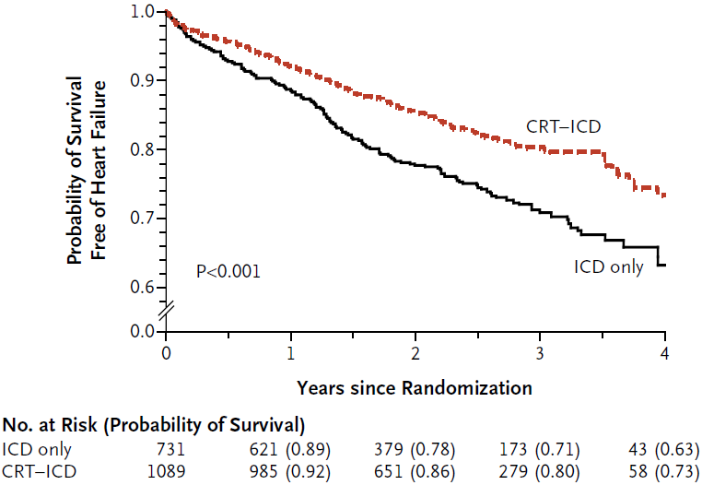
Background: MADIT-CRT
1820 ICM/NICM pts:
EF ≤ 30%
QRS ≥ 130 msec
NYHA I/II
Randomization:
CRT-D vs. ICD-only*
3:2 ratio
Mean Follow-Up:
2.4 yrs
Outcome:
HR=0.66 (p=0.001)
*Boston Scientific ICD and CRT-D devices
Moss A, et al. NEJM. 2009;361:1329-38

Slide 3
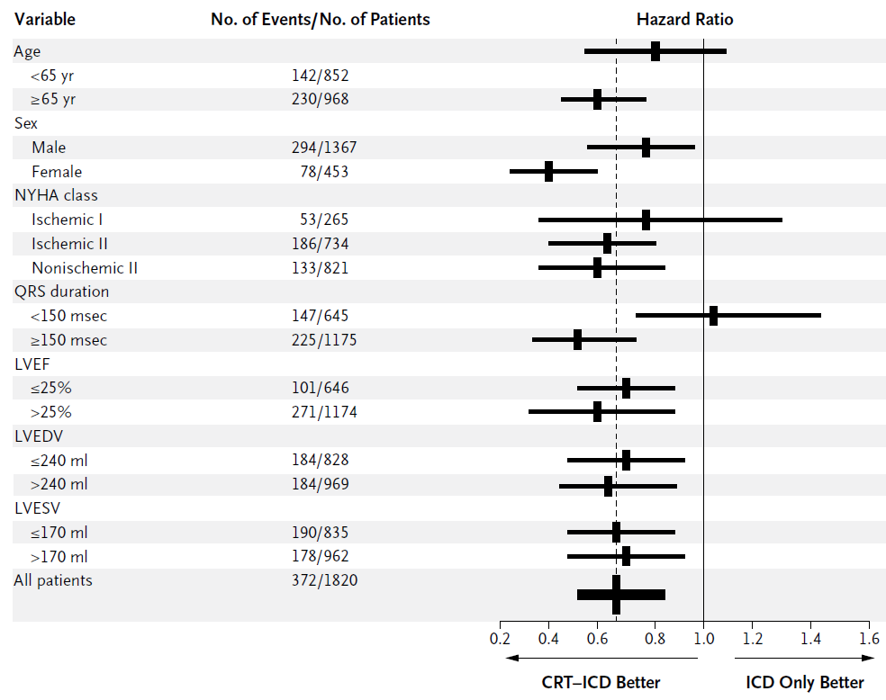
MADIT-CRT Subgroup Analysis
Differential clinical response: Gender, QRS duration
Moss A, et al. NEJM. 2009;361:1329-38

Slide 4
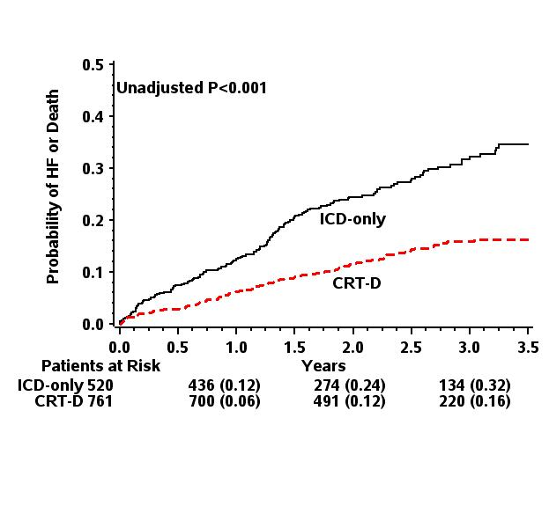
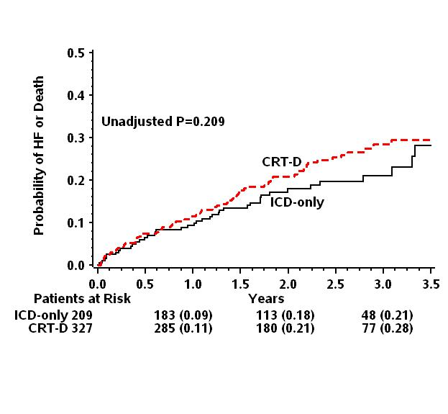
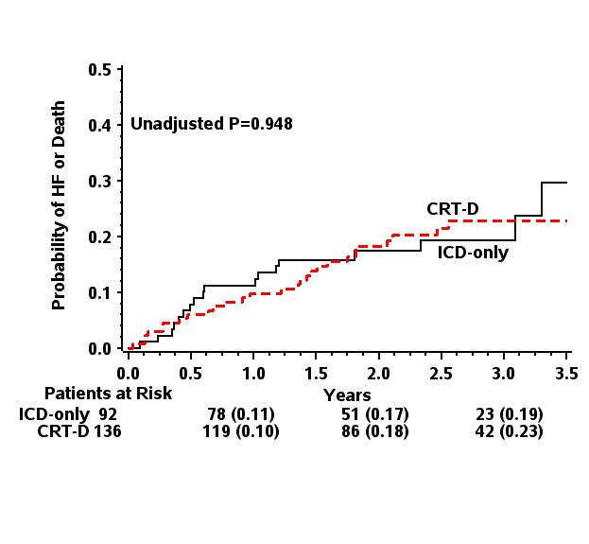
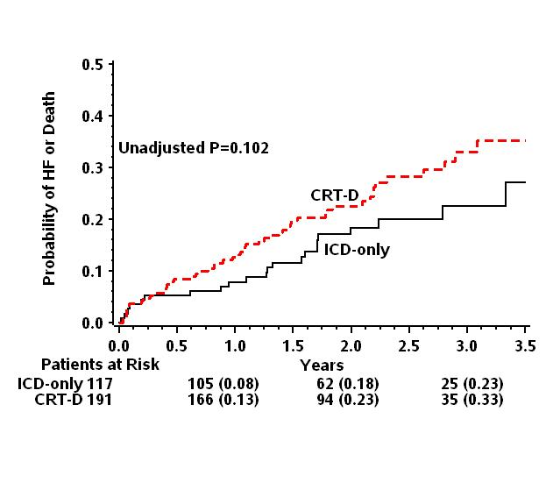
MADIT-CRT: QRS Morphology
LBBB
Non-LBBB
RBBB
IVCD
Zareba, W, et al. Circulation. 2011;123:1061-1072

Slide 5
MADIT-CRT Long-Term Follow-Up Study Purpose
Hypothesis: The pronounced reduction in heart failure events associated with CRT during the in-trial period of MADIT-CRT would translate into a long-term survival benefit

Slide 6
Population and Trial Periods
MADIT-CRT study: In-trial period
1820 patients:
88 US centers; 1,271 pts (70%)
24 Non-US Centers; 549 pts (30%)
In-trial period: December 22, 2004 – June 20, 2009
MADIT-CRT Long Term Follow-up: Post-trial period
1691 patients
Last in-trial follow-up visit – September 30, 2013

Slide 7
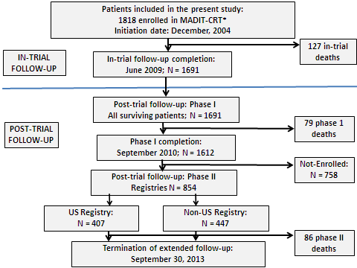
MADIT-CRT Long Term Follow-up: Study Design

Slide 8
Outcome Measures
Primary end point:
All-cause mortality from enrollment in MADIT-CRT through post-trial follow-up
Secondary endpoints:
Separate occurrence of non-fatal HF events
Combined end point of non-fatal HF event or death

Slide 9
Statistical Analysis
All analyses performed:
On an intention-to-treat basis by original treatment allocation regardless of in-trial and post-trial crossovers
By LBBB status at enrollment with interaction-term analysis

Slide 10
Results

Slide 11
Follow-Up Data
Follow-up time:
In-trial: 2.4 yrs (IQR = 1.8 – 3.2)
Post-trial: 5.6 years (IQR = 5.1 – 6.4)
Device change:
ICD to CRT-D: 9%
CRT-D to ICD: 5%
Clinical events:
292 pts died (16%)
442 pts experienced a non-fatal HF event (24%)

Slide 12
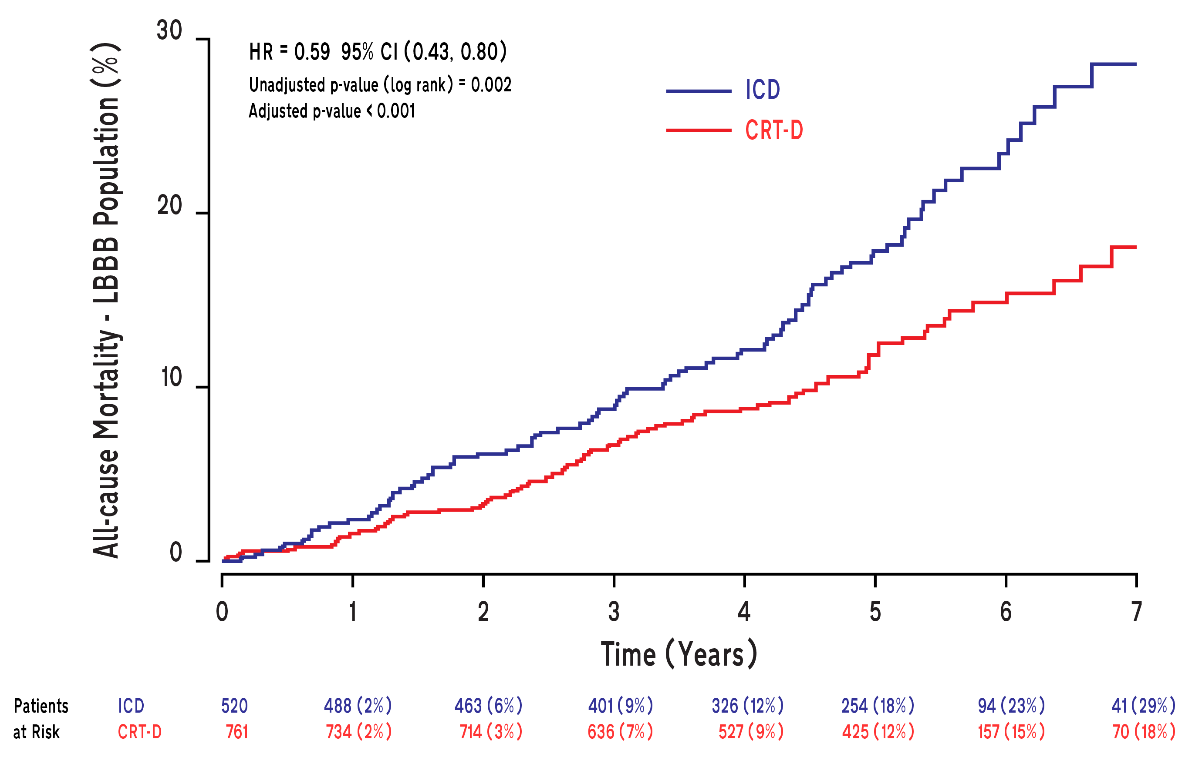
LBBB: All-Cause Mortality
NNT = 9

Slide 13
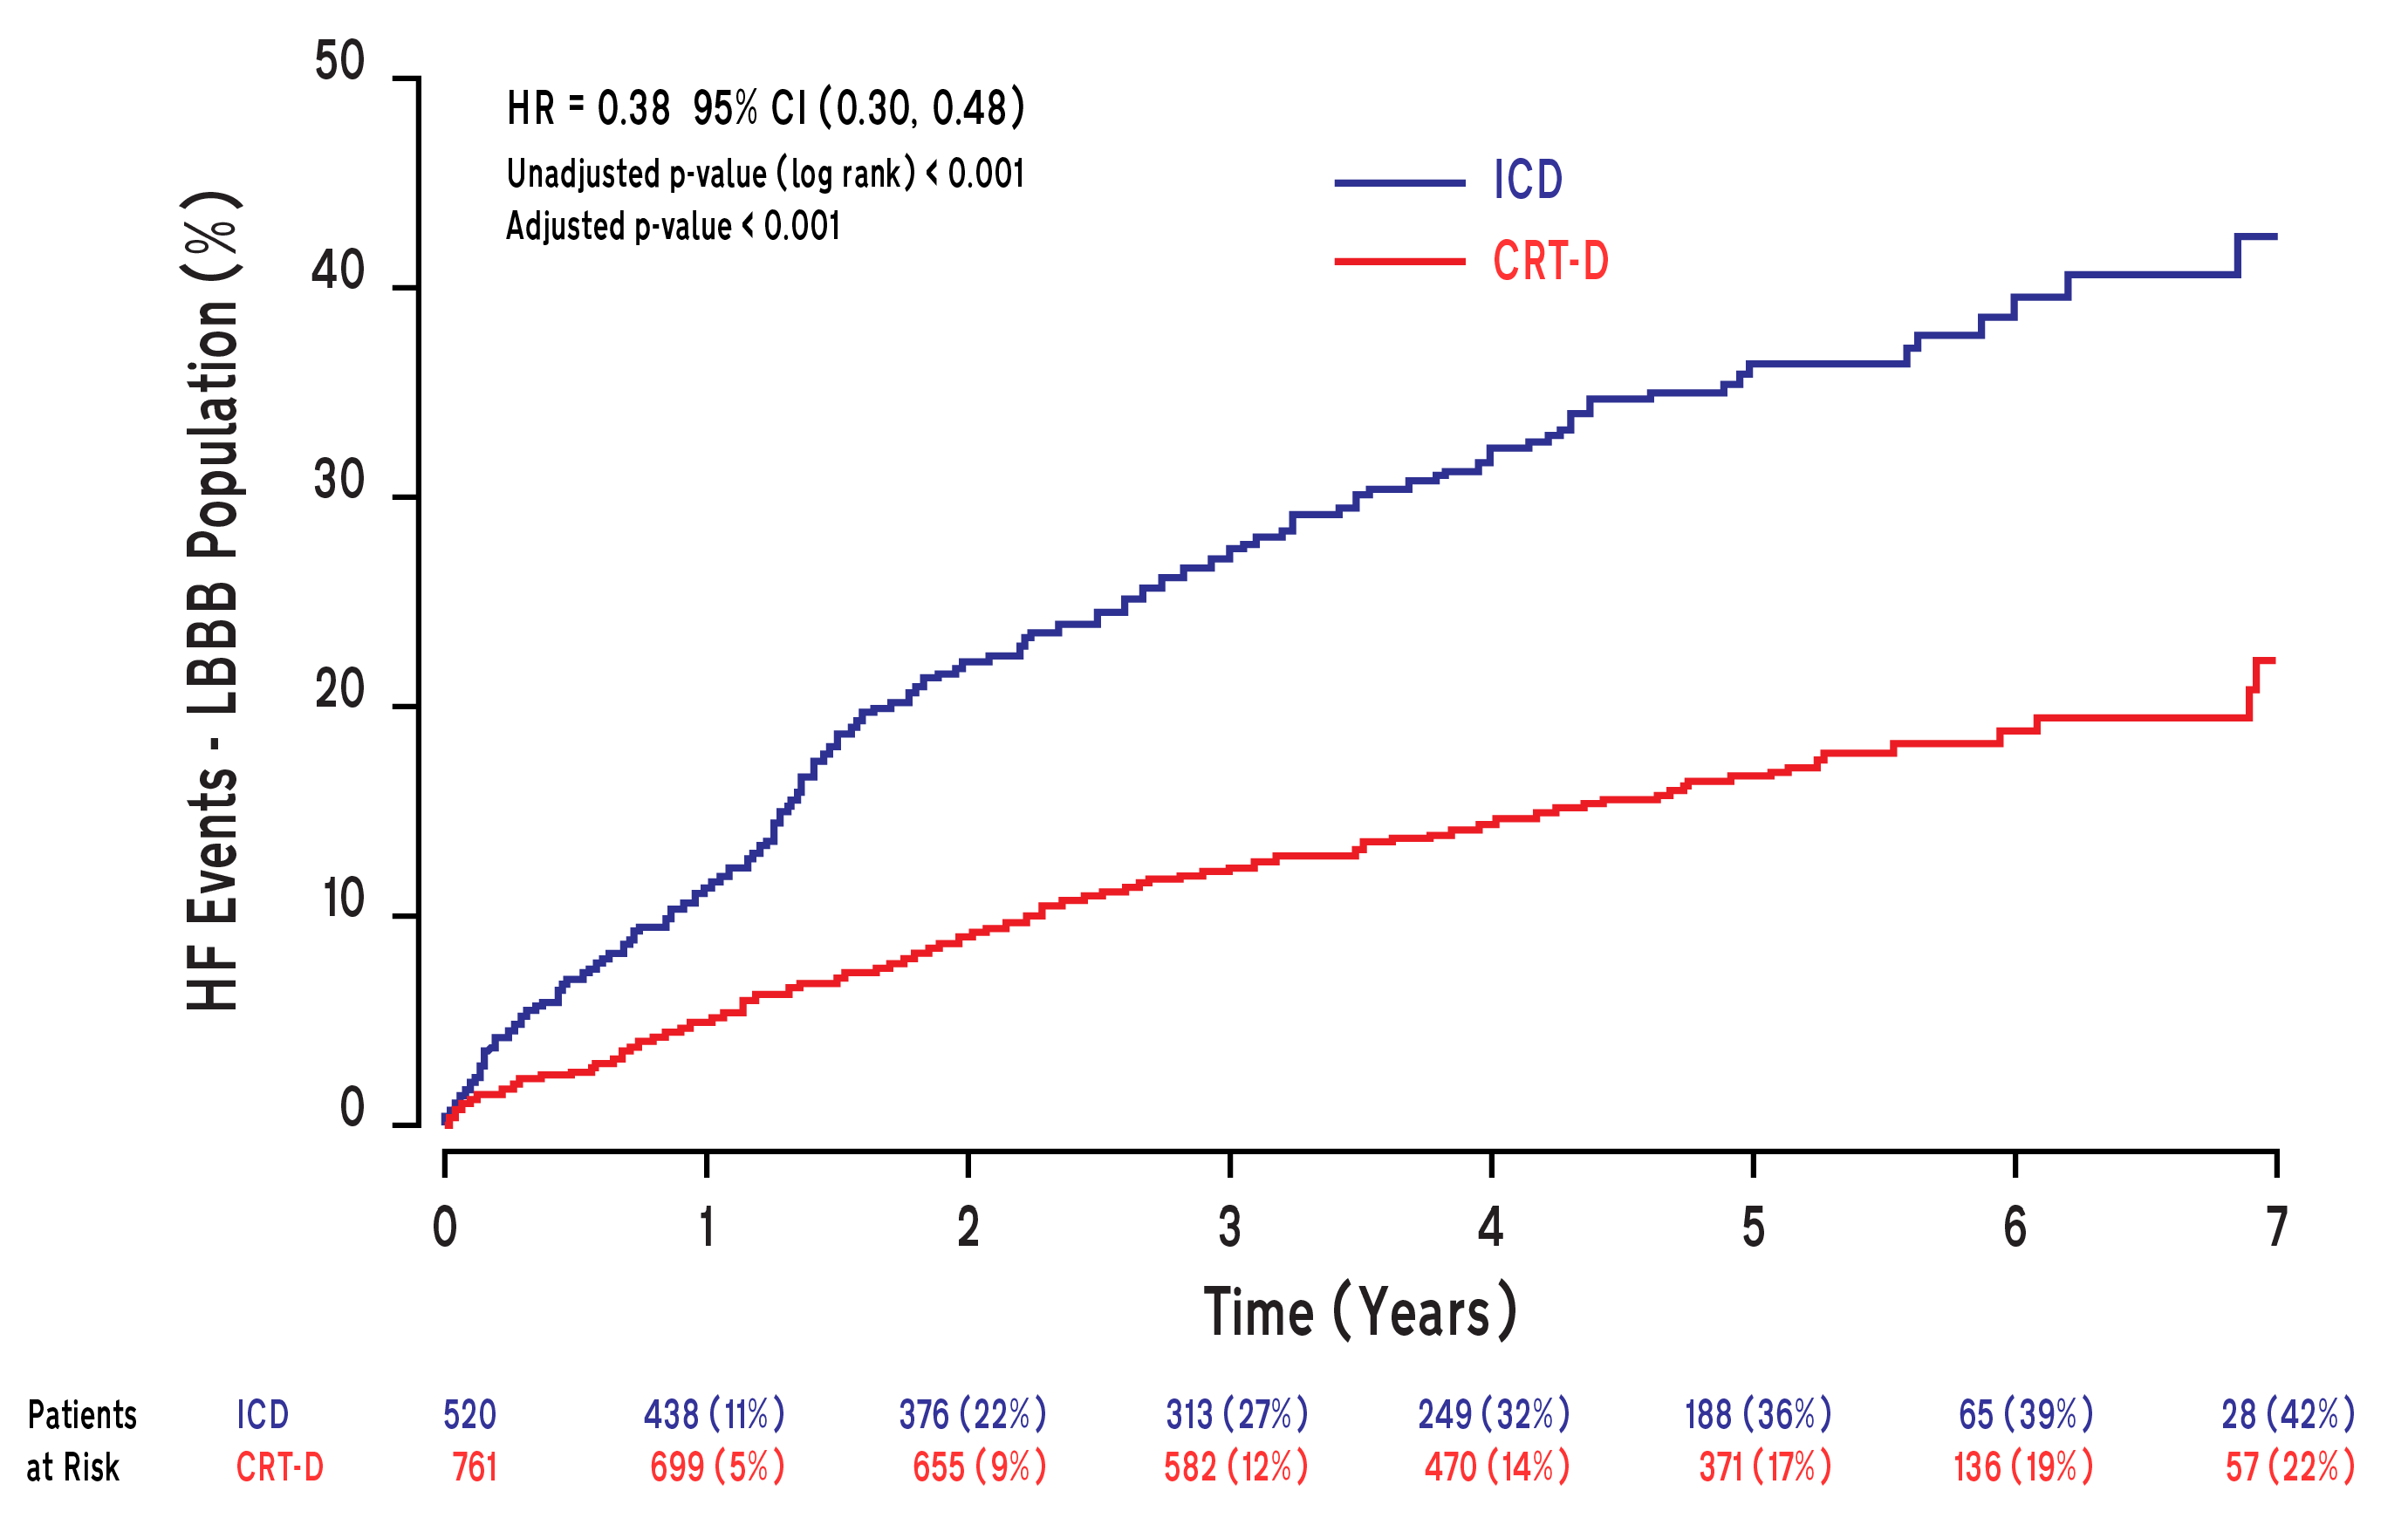
LBBB: Non-Fatal Heart Failure Events

Slide 14
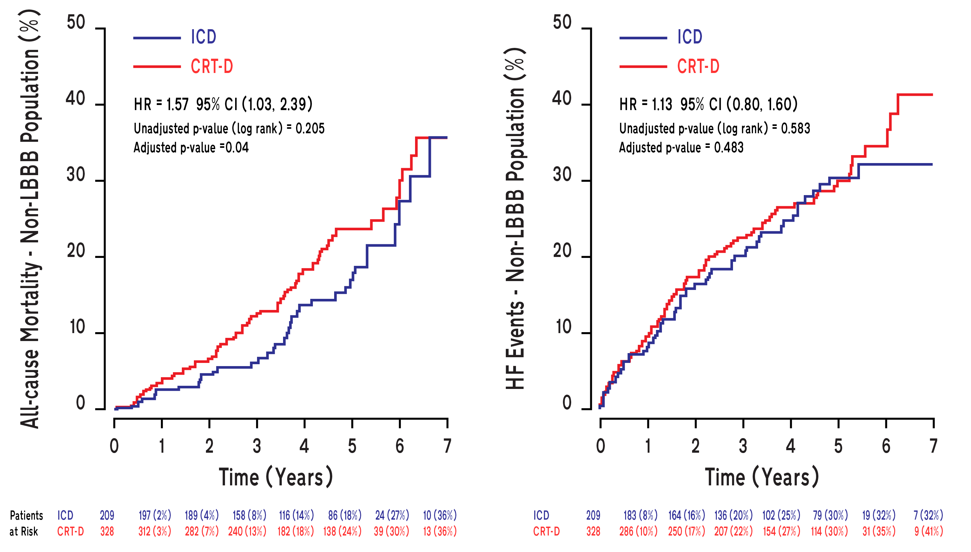
Non-LBBB
All-Cause Mortality
Non-Fatal Heart Failure Events

Slide 15
Multivariate Analysis Survival Benefit of CRT-D by LBBB Status
 | LBBB |  | Non-LBBB |  | P-Interaction
End Point | HR (95% CI) | P-value | HR (95% CI) | P-value
All-cause mortality | 0.59 (0.43 – 0.80) | <0.001 | 1.57 (1.03 – 2.39) | 0.04 | <0.001
Non-fatal HF | 0.38 (0.30 – 0.48) | <0.001 | 1.13 (0.80 – 1.60) | 0.48 | <0.001
HF or death | 0.45 (0.37 – 0.56) | <0.001 | 1.27 (0.94 – 1.73) | 0.12 | <0.001
Findings are further adjusted for age at enrollment, serum creatinine ≥ 1.4 mg/dL, smoking status, diabetes mellitus, etiology of cardiomyopathy, LV end systolic volume, QRS duration ≥ 150 ms , NYHA class > II at 3 months prior to enrollment.

Slide 16
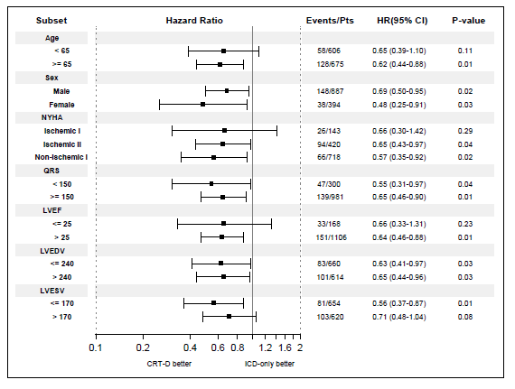
LBBB Subgroup Analysis

Slide 17
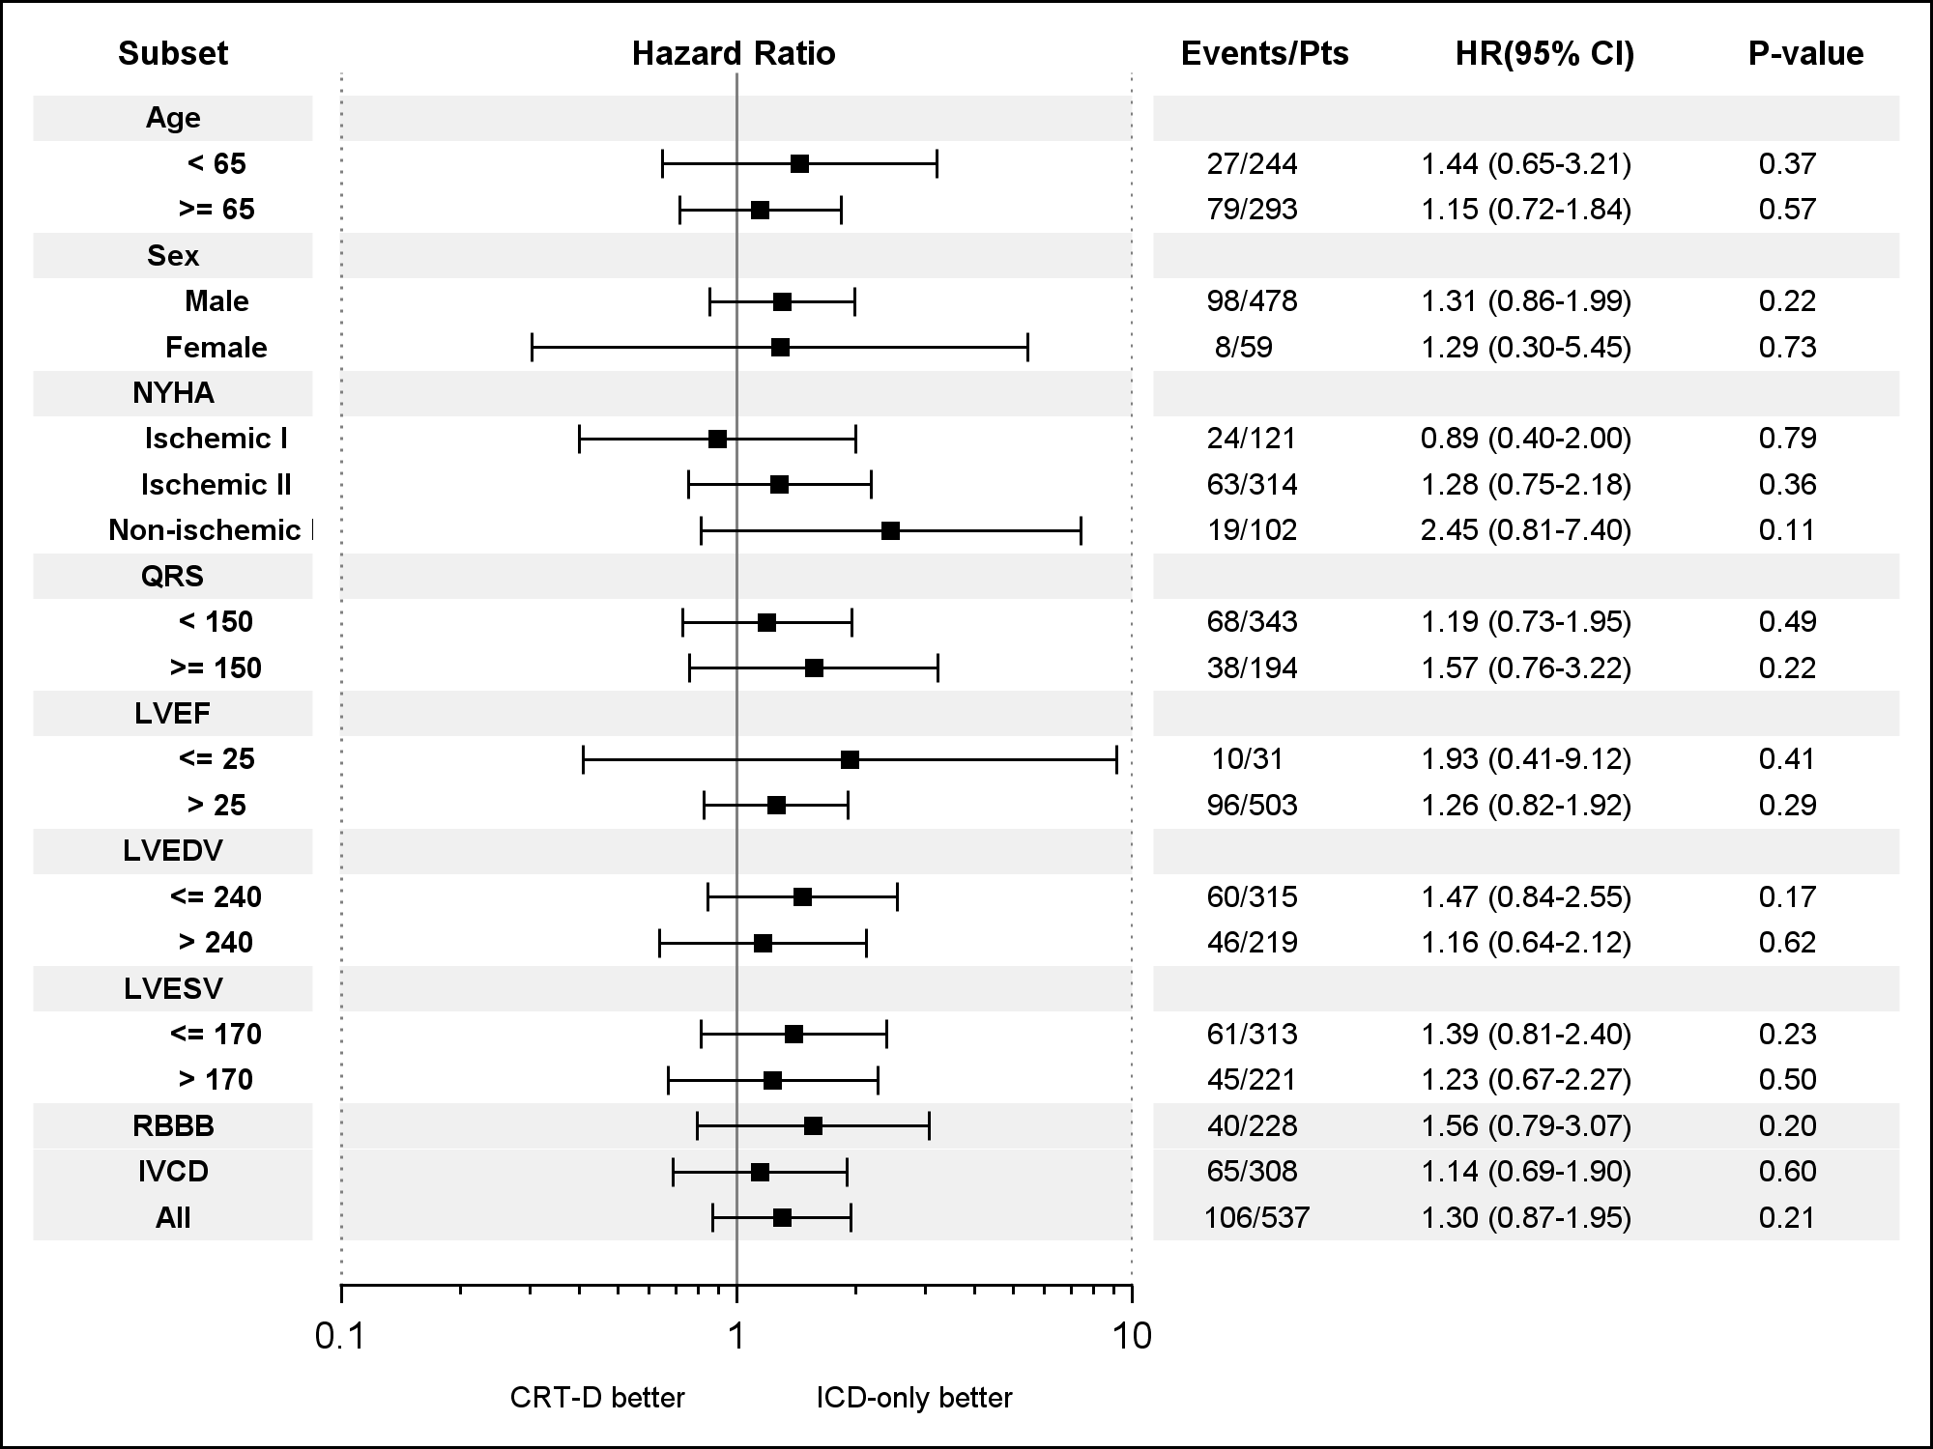
Non-LBBB Subgroup Analysis

Slide 18
Summary
In patients with mild heart failure symptoms, left ventricular dysfunction, and LBBB, early intervention with CRT is associated with a significant long-term survival benefit
No survival benefit found in mild heart failure patients without LBBB

Slide 19
CRT-D Systems from Boston Scientific
Indications and Usage
These Boston Scientific Cardiac Resynchronization Therapy Defibrillators (CRT-Ds) are indicated for patients with heart failure who receive stable optimal pharmacologic therapy (OPT) for heart failure and who meet any one of the following classifications:
Moderate to severe heart failure (NYHA Class III-IV) with EF ≤ 35% and QRS duration ≥ 120 ms
Left bundle branch block (LBBB) with QRS ≥ 130 ms, EF ≤ 30%, and mild (NYHA Class II) ischemic or nonischemic heart failure or asymptomatic (NYHA Class I) ischemic heart failure
Contraindications
There are no contraindications for this device.
Warnings
Read the product labeling thoroughly before implanting the pulse generator to avoid damage to the system. For single patient use only. Do not reuse, reprocess, or resterilize. Program the pulse generator Tachy Mode to Off during implant, explant or postmortem procedures. Always have sterile external and internal defibrillator protection available during implant. Ensure that an external defibrillator and medical personnel skilled in CPR are present during post-implant device testing. Advise patients to seek medical guidance before entering environments that could adversely affect the operation of the active implantable medical device, including areas protected by a warning notice that prevents entry by patients who have a pulse generator. Do not expose a patient to MRI device scanning. Do not subject a patient with an implanted pulse generator to diathermy, Do not use atrial-tracking modes in patients with chronic refractory atrial tachyarrhythmias. Do not use atrial-only modes in patients with heart failure. LV lead dislodgment to a position near the atria can result in atrial oversensing and LV pacing inhibition. Physicians should use medical discretion when implanting this device in patients who present with slow VT. Do not kink, twist or braid the lead with other leads. Do not use defibrillation patch leads with the CRT-D system. Do not use this pulse generator with another pulse generator.
Precautions
For specific information on precautions, refer to the following sections of the product labeling: clinical considerations; sterilization, storage and handling; implant and device programming; follow-up testing; explant and disposal; environmental and medical therapy hazards; hospital and medical environments; home and occupational environments. Advise patients to avoid sources of electromagnetic interference (EMI) because EMI may cause the pulse generator to deliver inappropriate therapy or inhibit appropriate therapy.
Potential Adverse Events
Potential adverse events from implantation of the CRT-D system include, but are not limited to, the following: allergic/physical/physiologic reaction, death, erosion/migration, fibrillation or other arrhythmias, lead or accessory breakage (fracture/insulation/lead tip), hematoma/seroma, inappropriate or inability to provide therapy (shocks/pacing/sensing), infection, procedure related, and component failure. Patients may develop psychological intolerance to a pulse generator system and may experience fear of shocking, fear of device failure, or imagined shocking. In rare cases severe complications or device failures can occur.
Refer to the product labeling for specific indications, contraindications, warnings/precautions and adverse events. Rx only.
(Rev. Q)

Slide 20
CRT-D Systems from Boston Scientific – PUNCTUA, ENERGEN, and INCEPTA
Indications and Usage
The PUNCTUATM, ENERGENTM, and INCEPTATM Cardiac Resynchronization Therapy Defibrillators (CRT-Ds) are indicated for patients with heart failure who receive stable optimal pharmacologic therapy (OPT) for heart failure and who meet any one of the following classifications:
Moderate to severe heart failure (NYHA Class III-IV) with EF ≤ 35% and QRS duration ≥ 120 ms
Left bundle branch block (LBBB) with QRS ≥ 130 ms, EF ≤ 30%, and mild (NYHA Class II) ischemic or nonischemic heart failure or asymptomatic (NYHA Class I) ischemic heart failure
Contraindications
There are no contraindications for this device.
Warnings
Read the product labeling thoroughly before implanting the pulse generator to avoid damage to the system. For single patient use only. Do not reuse, reprocess, or resterilize. Program the pulse generator Tachy Mode to Off during implant, explant or postmortem procedures. Always have external defibrillator protection available during implant. Ensure that an external defibrillator and medical personnel skilled in CPR are present during post-implant device testing. Advise patients to seek medical guidance before entering environments that could adversely affect the operation of the active implantable medical device, including areas protected by a warning notice that prevents entry by patients who have a pulse generator. Do not expose a patient to MRI device scanning.. Do not subject a patient with an implanted pulse generator to diathermy, Do not use atrial-tracking modes in patients with chronic refractory atrial tachyarrhythmias. Do not use atrial-only modes in patients with heart failure. LV lead dislodgment to a position near the atria can result in atrial oversensing and LV pacing inhibition. Physicians should use medical discretion when implanting this device in patients who present with slow VT. Do not kink, twist or braid the lead with other leads. Do not use defibrillation patch leads with the CRT-D system. Do not use this pulse generator with another pulse generator.
For DF4-LLHH or DF4-LLHO leads, use caution handling the lead terminal when the Connector Tool is not present on the lead and do not directly contact the lead terminal with any surgical instruments or electrical connections such as PSA (alligator) clips, ECG connections, forceps, hemostats, and clamps. Do not contact any other portion of the DF4-LLHH or DF4-LLHO lead terminal, other than the terminal pin even when the lead cap is in place.
Precautions
For specific information on precautions, refer to the following sections of the product labeling: clinical considerations; sterilization and storage; implantation; device programming; follow-up testing; explant and disposal; environmental and medical therapy hazards; hospital and medical environments; home and occupational environments; and supplemental precautionary information. Advise patients to avoid sources of electromagnetic interference (EMI) because EMI may cause the pulse generator to deliver inappropriate therapy or inhibit appropriate therapy.
Potential Adverse Events
Potential adverse events from implantation of the CRT-D system include, but are not limited to, the following: allergic/physical/physiologic reaction, death, erosion/migration, fibrillation or other arrhythmias, lead or accessory breakage (fracture/insulation/lead tip), hematoma/seroma, inappropriate or inability to provide therapy (shocks/pacing/sensing), infection, procedure related, and component failure. Patients may develop psychological intolerance to a pulse generator system and may experience fear of shocking, fear of device failure, or imagined shocking. In rare cases severe complications or device failures can occur.
Refer to the product labeling for specific indications, contraindications, warnings/precautions and adverse events. Rx only.
(Rev. A)

Slide 21
ICD Systems from Boston Scientific
ICD Indications and Usage
ICDs are intended to provide ventricular antitachycardia pacing and ventricular defibrillation for automated treatment of life-threatening ventricular arrhythmias. ICDs (i.e. Vitality AVT) with atrial therapies are also intended to provide atrial antitachycardia pacing and atrial defibrillation treatment in patients who have or are at risk of developing atrial tachyarrhythmias.
Contraindications
Use of ICD systems are contraindicated in: Patients whose ventricular tachyarrhythmias may have reversible cause, such as 1) digitalis intoxication, 2) electrolyte imbalance, 3) hypoxia, or 4) sepsis, or whose ventricular tachyarrhythmias have a transient cause, such as 1) acute myocardial infarction, 2) electrocution, or 3) drowning. Patients who have a unipolar pacemaker.
Warnings
Read the product labeling thoroughly before implanting the pulse generator to avoid damage to the ICD system. For single patient use only, Do not reuse, reprocess, or resterilize. Program the pulse generator ventricular Tachy Mode to Off during implant, explant or post-mortem procedures. Always have external defibrillator protection available during implant. Ensure that an external defibrillator and medical personnel skilled in cardiopulmonary resuscitation (CPR) are present during post-implant device testing. Patients should seek medical guidance before entering environments that could adversely affect the operation of the active implantable medical device, including areas protected by a warning notice that prevents entry by patients who have a pulse generator. Do not expose a patient to MRI device scanning. Do not subject a patient with an implanted pulse generator to diathermy. Do not use atrial tracking modes (or an AVT device) in patients with chronic refractory atrial tachyarrhythmias. Do not use this pulse generator with another pulse generator. Do not kink, twist or braid lead with other leads..
Precautions
For specific information on precautions, refer to the following sections of the product labeling: clinical considerations; sterilization and storage; implantation; device programming; environmental and medical therapy hazards; hospital and medical environments; home and occupational environments follow-up testing; explant and disposal; supplemental precautionary information. Advise patients to avoid sources of electromagnetic interference (EMI).
Potential Adverse Events
Potential adverse events from implantation of the ICD system include, but are not limited to, the following: allergic/physical/physiologic reaction, death, erosion/migration, fibrillation or other arrhythmias, lead or accessory breakage (fracture/insulation/lead tip), hematoma/seroma, inappropriate or inability to provide therapy (shocks/pacing/sensing), infection, procedure related, psychologic intolerance to an ICD system – patients susceptible to frequent shocks despite antiarrhythmic medical management/imagined shocking, and component failure. In rare cases severe complications or device failures can occur.
Refer to the product labeling for specific indications, contraindications, warnings/ precautions and adverse events. Rx only.
(Rev. P)

Slide 22
ICD Systems from Boston Scientific – PUNCTUA, ENERGEN, and INCEPTA
ICD Indications and Usage
PUNCTUATM, ENERGENTM, and INCEPTATM ICDs are intended to provide ventricular antitachycardia pacing and ventricular defibrillation for automated treatment of life-threatening ventricular arrhythmias.
Contraindications
Use of these ICD systems are contraindicated in: Patients whose ventricular tachyarrhythmias may have reversible cause, such as 1) digitalis intoxication, 2) electrolyte imbalance, 3) hypoxia, or 4) sepsis, or whose ventricular tachyarrhythmias have a transient cause, such as 1) acute myocardial infarction, 2) electrocution, or 3) drowning. Patients who have a unipolar pacemaker.
Warnings
Read the product labeling thoroughly before implanting the pulse generator to avoid damage to the ICD system. For single patient use only. Do not reuse, reprocess, or resterilize. Program the pulse generator ventricular Tachy Mode to Off during implant, explant or post-mortem procedures. Always have external defibrillator protection available during implant. Ensure that an external defibrillator and medical personnel skilled in cardiopulmonary resuscitation (CPR) are present during post-implant device testing. Patients should seek medical guidance before entering environments that could adversely affect the operation of the active implantable medical device, including areas protected by a warning notice that prevents entry by patients who have a pulse generator. Do not expose a patient to MRI device scanning. Do not subject a patient with an implanted pulse generator to diathermy. Do not use atrial tracking modes in patients with chronic refractory atrial tachyarrhythmias. Do not use this pulse generator with another pulse generator. Do not kink, twist or braid lead with other leads. For DF4-LLHH or DF4-LLHO leads, use caution handling the lead terminal when the Connector Tool is not present on the lead and do not directly contact the lead terminal with any surgical instruments or electrical connections such as PSA (alligator) clips, ECG connections, forceps, hemostats, and clamps. Do not contact any other portion of the DF4-LLHH or DF4-LLHO lead terminal, other than the terminal pin even when the lead cap is in place.
Precautions
For specific information on precautions, refer to the following sections of the product labeling: clinical considerations; sterilization and storage; implantation; device programming; environmental and medical therapy hazards; hospital and medical environments; home and occupational environments follow-up testing; explant and disposal; supplemental precautionary information. Advise patients to avoid sources of electromagnetic interference (EMI).
Potential Adverse Events
Potential adverse events from implantation of the ICD system include, but are not limited to, the following: allergic/physical/physiologic reaction, death, erosion/migration, fibrillation or other arrhythmias, lead or accessory breakage (fracture/insulation/lead tip), hematoma/seroma, inappropriate or inability to provide therapy (shocks/pacing/sensing), infection, procedure related, psychologic intolerance to an ICD system – patients susceptible to frequent shocks despite antiarrhythmic medical management/imagined shocking, and component failure. In rare cases severe complications or device failures can occur.
Refer to the product labeling for specific indications, contraindications, warnings/ precautions and adverse events. Rx only.
(Rev. A)

